Slide 1







React JS:
Intro, State & Props
Mohit Raj Purohit
Proudly recognized by

Slide 2
React Introduction
Vite React
React Router
ESLint
Agenda

Slide 3
React Introduction

Slide 4
What is React?
React is a JavaScript library for building user interfaces.
Developed and maintained by Facebook.
Component-based architecture.
Efficient rendering using the Virtual DOM.
We can build SPA. Single Page Application (SPA) is a web application that dynamically updates content without reloading the entire page.

Slide 5
JSX
What is JSX?
JSX is a syntax extension for JavaScript.
Allows writing HTML-like code inside JS.
Transpiled to React.createElement() calls by Babel.
Key Features
Embeds expressions with {}.
Can have nested elements.
Attributes follow camelCase (className, onClick).
JSX is not a string or HTML, it’s syntactic sugar for React.createElement.

Slide 6
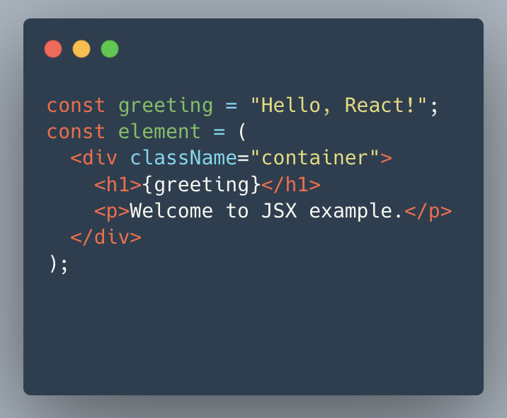
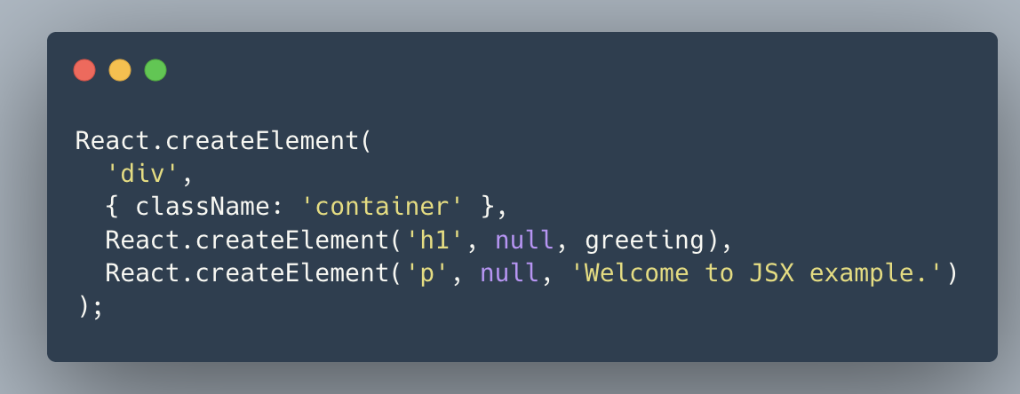
JSX Example
Transpile

Slide 7
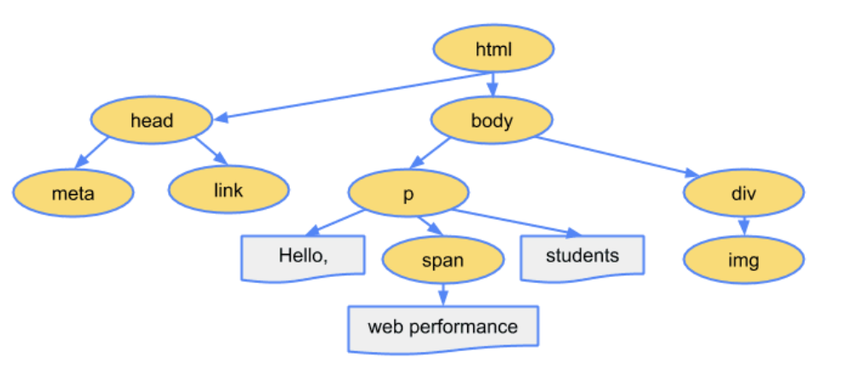
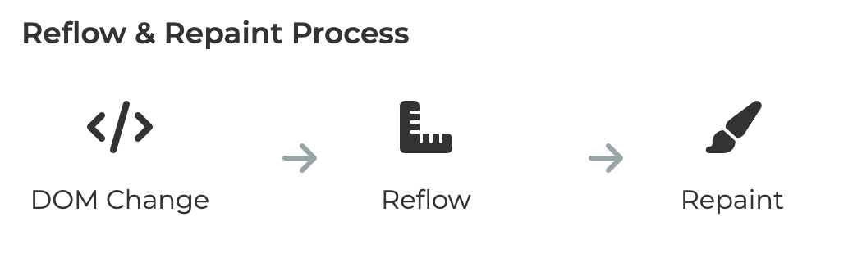
DOM Tree Structure

Slide 8
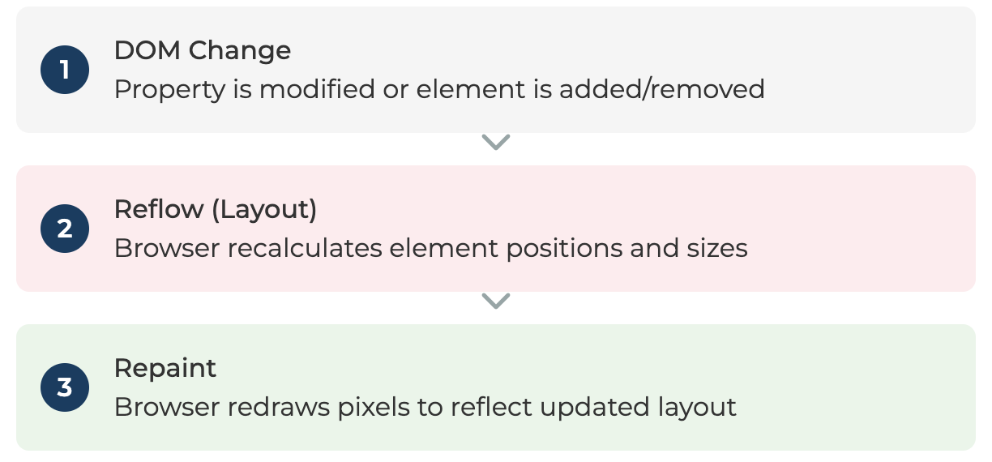
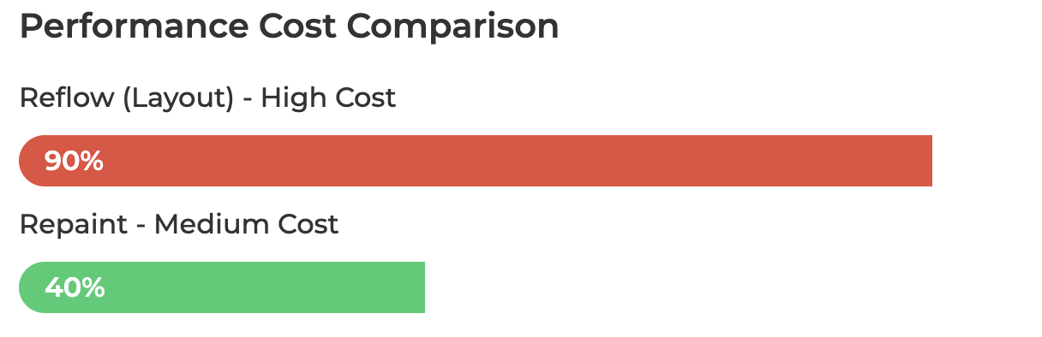
What is Reflow(Layout) and Repaint
Reflow(Layout) - Recalculating the positions and dimensions of all elements in the document flow. Triggered when layout-affecting properties change. Example - width/height change, font-weight change, adding DOM element Repaint - Redrawing pixels to the screen without recalculating layout. Triggered by visual-only property changes. Example - background-color change, text color change, shadow change Reflow ALWAYS triggers Repaint, but Repaint can occur alone

Slide 9
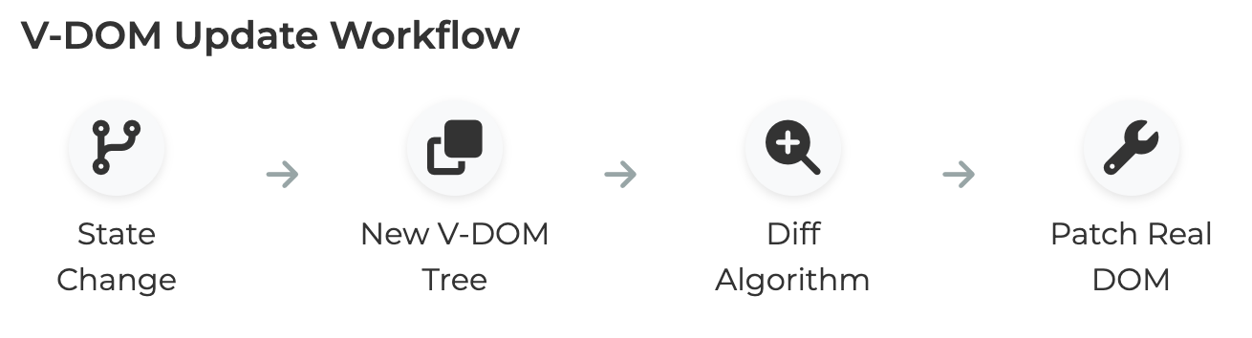
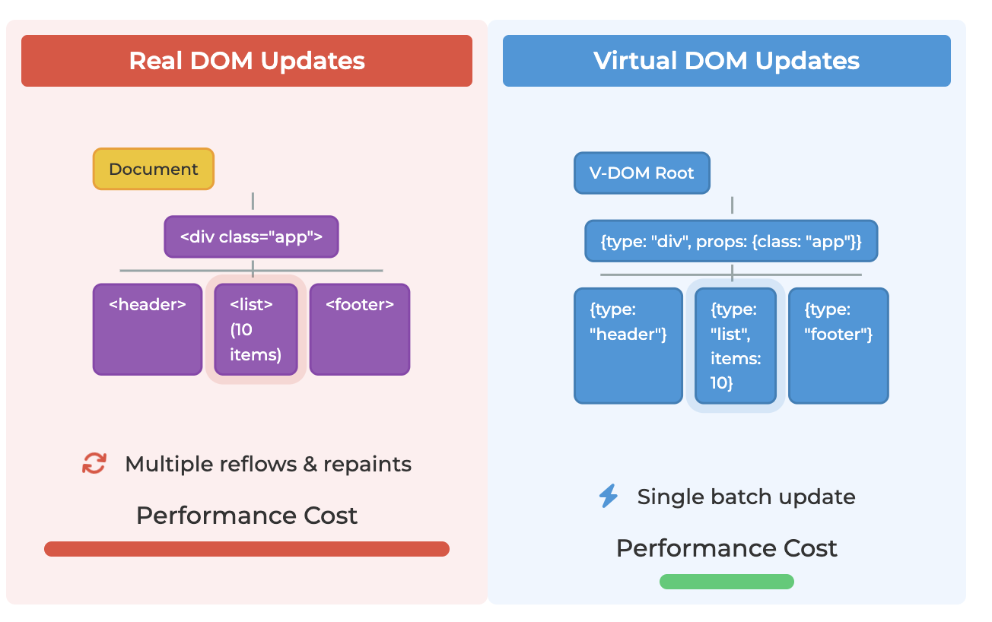
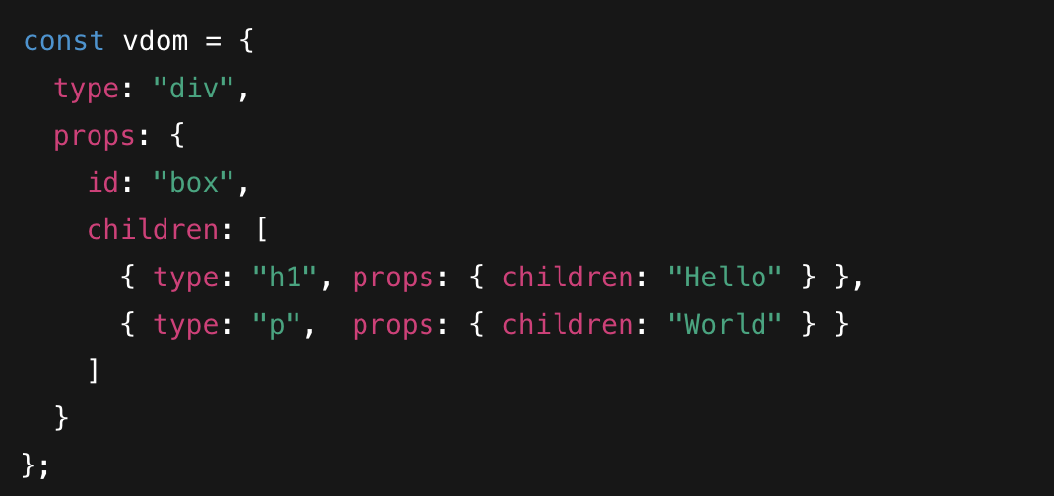
How React Minimizes Reflow & Repaint
React updates a Virtual DOM instead of the real DOM first, which avoids unnecessary layout calculations.
It compares the old and new Virtual DOM using Diffing, and finds the smallest possible changes.
Only the affected DOM nodes are updated, not the entire tree — reducing Reflow/Repaint cost.
Batching updates ensures multiple state changes cause only one DOM update, not multiple.
React Fiber optimizes rendering by breaking work into small chunks and prioritizing important updates.

Slide 10
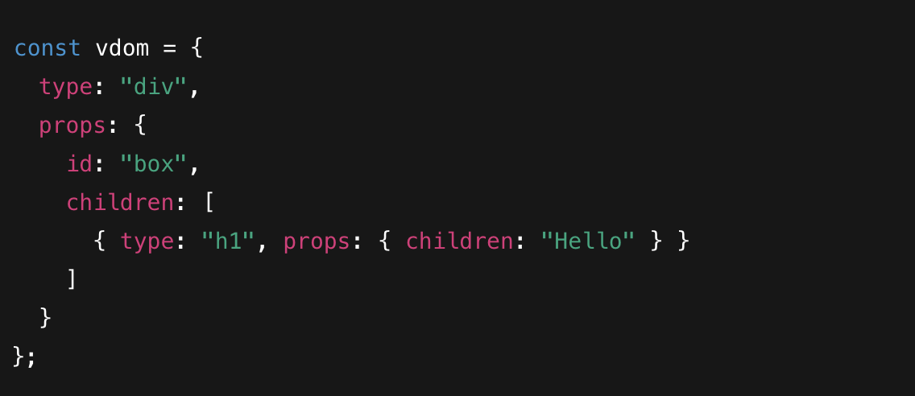
Virtual DOM
The Virtual DOM (VDOM) is a lightweight copy of the actual DOM (Document Object Model) that helps optimize updates and improve performance in web applications. It is mainly used in libraries like React to efficiently update the UI.
Benefits:
Smooth UI updates
Minimal reflows + repaints
High performance under heavy UI changes

Slide 11
Reconciliation
What Is Reconciliation?
Reconciliation is the process React uses to update the DOM efficiently.
It compares the new virtual DOM with the previous virtual DOM to determine the minimal changes required.
This process is also called “diffing”.
How It Works:
Virtual DOM Update: React creates a new virtual DOM tree when state or props change.
Diffing: React compares the new virtual DOM with the previous one.
Minimal Updates: Only the elements that actually changed are updated in the real DOM.
Key Points / Benefits:
Performance: Reduces unnecessary DOM manipulations.
Predictable UI updates: Ensures the UI reflects the latest state.
Faster Rendering: Optimizes re-rendering by avoiding full DOM updates.

Slide 12
React Diffing Algorithm
Elements Of Different Types → Full Replace Example - <div> → <span>
DOM Elements Of The Same Type → Only updates the changed attributes Example - <div className="before" title="stuff" /> <div className="after" title="stuff" /> Or <div style={{color: 'red', fontWeight: 'bold'}} /> <div style={{color: 'green', fontWeight: 'bold'}} />
Children Diffing Optimization
Linear comparison of children.
Uses keys to match elements.

Slide 13

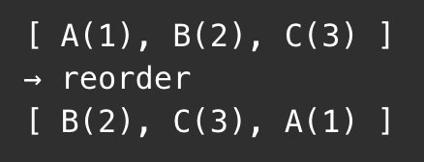
Diffing with and without Keys
Keys Make Diffing Faster
Stable identity during reordering.
Prevents unnecessary node destruction.
Without Keys (Bad Case) React compares index-to-index → mismatches → more DOM operations
React may delete and recreate unnecessarily.
With Keys(Best Case) React directly matches items using keys.
React reuses nodes instead of deleting/creating.

Slide 14
Vite React

Slide 15
Vite
What is Vite?
Next‑generation frontend build tool.
Created by Evan You (same creator as Vue).
Designed for speed using native ES modules.
Why Vite for React?
Instant server start — no bundling on startup.
Hot Module Replacement (HMR) is ultra fast.
Lightning-fast builds via Rollup.
Minimal configuration, perfect for React apps.
How Vite Works Internally
Dev mode → ESM-based serving (no bundling).
Prod mode → Uses Rollup for optimized bundles.
Code-splitting + Tree-shaking enabled out of the box.

Slide 16
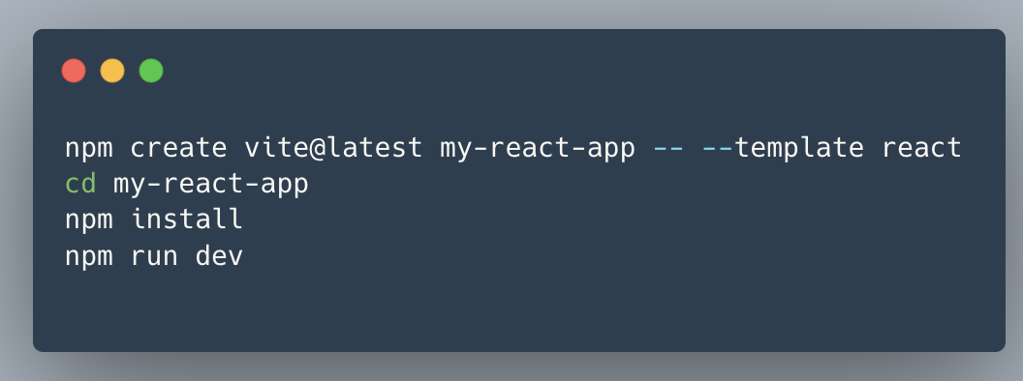
Vite Project Creation
https://vite.dev/guide/#scaffolding-your-first-vite-project

Slide 17
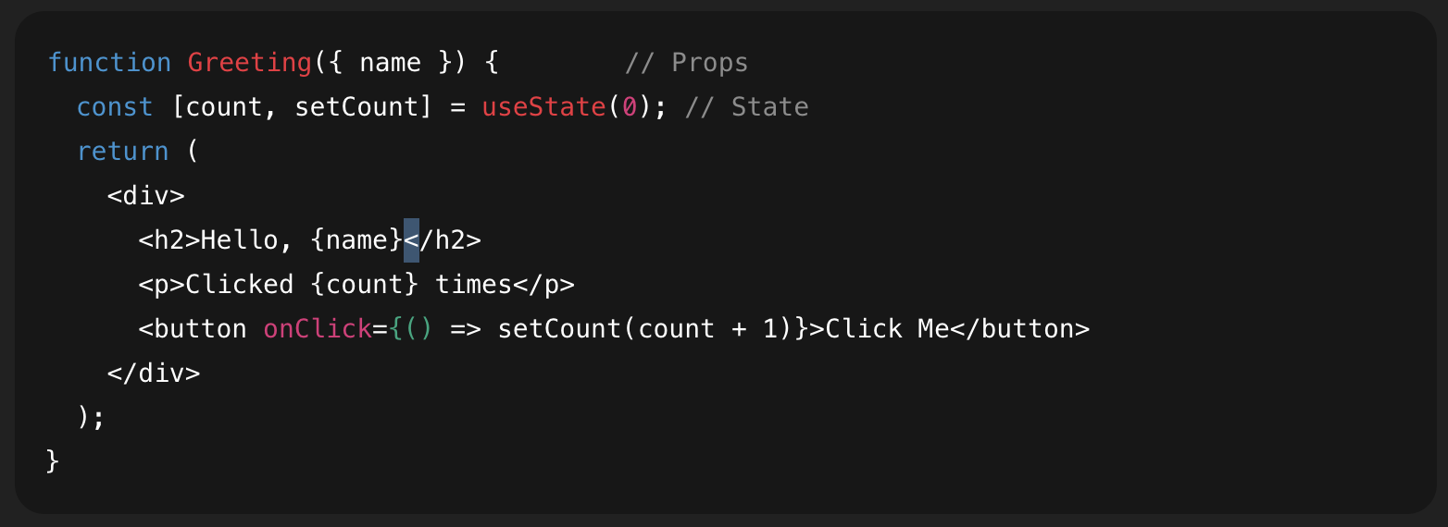
Props and States
Props (Properties):
Read-only inputs passed from parent to child components.
Used to configure, customize, and reuse components.
Immutable — cannot be changed by the receiving component.
State:
Data owned and managed inside a component.
Used to store dynamic values that change over time (like input fields, counters, toggles).
Mutable — can be updated using setState or useState.

Slide 18
Synthetic Events
What Are Synthetic Events?
Synthetic Events are React’s wrapper around the browser’s native events.
They provide a consistent cross-browser interface for event handling.
Key points
SyntheticEvent mimics native event — same interface (preventDefault(), stopPropagation()).
React manages all events through a single listener per event type at the root.
Example onClick, onDoubleClick, onMouseEnter, onMouseLeave, onMouseMove, onMouseDown, onMouseUp, onContextMenu, onKeyDown, onKeyPress, onKeyUp, onChange, onInput, onSubmit, onFocus, onBlur, onCopy, onCut, onPaste, onCompositionStart, onCompositionUpdate, onCompositionEnd, onDrag, onDragStart, onDragOver, onDrop, onTouchStart, onTouchMove, onTouchEnd, onPointerDown, onPointerMove, onPointerUp, onLoad, onError, onScroll, onWheel

Slide 19
React Hook (useState)
What is useState?
A React Hook that lets you add state to functional components.
It returns a state variable and a function to update it.
State updates cause re-rendering of the component.
Example -
const [state, setState] = useState(initialValue);

Slide 20
React Hook (useEffect)
Hooks are special functions that let you “hook into” React features (like state and lifecycle) from functional components. What is useEffect?
A Hook for performing side effects in React components.
Side effects are operations that affect something outside the component — e.g., 👉 API calls, DOM manipulation, timers, subscriptions, etc.
Syntax -
useEffect(() => {
// Side effect logic here
return () => {
// Optional cleanup
};
}, [dependencies]);

Slide 21
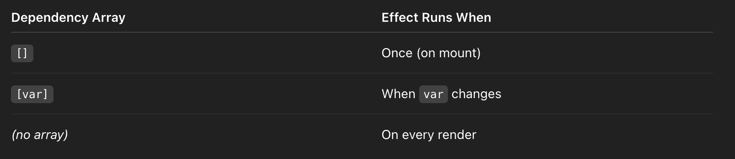
React Hook (useEffect)
When does it run?

Slide 22
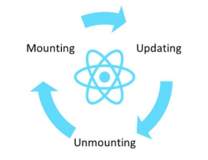
React Component Lifecycle

Slide 23
React Router

Slide 24
Routing in React
Navigation Before SPAs
Before SPAs, websites typically followed the Multi-Page Application (MPA) model, where each page had its own HTML file. Navigation was done using <a> tags, which caused a full-page reload every time a user clicked a link.
Methods of Navigation in Traditional Websites ->
Anchor Tags (<a href="page.html">Go to Page</a>)
Clicking an anchor tag loads a new HTML page.
Causes a full page reload, losing the existing state.
Form Submission (<form action="page.html" method="GET/POST">)
Used to send user input to another page.
Results in a new page load.

Slide 25
Navigating Between Pages Using JavaScript
Before React Router, JavaScript allowed navigation using the window.location object and the History API.
Using window.location for Navigation
window.location.href = "https://example.com/new-page";
This redirects to another page but causes a full reload.
Using the History API for Navigation
Modern browsers introduced the History API, which allows developers to change the URL dynamically without reloading the page.
Example: history.pushState({ data: "someData" }, "New Page", "/new-page");
Updates the URL and allows users to navigate back and forth using the browser buttons.
window.onpopstate = (event) => {
console.log("User navigated back!", event.state);
};

Slide 26
Why React Router?
While JavaScript methods like window.location and history.pushState allow navigation, they have limitations:
No built-in state management: Passing data between routes requires workarounds.
Manual event listeners: Developers need to manually handle navigation changes.
No declarative routing: Traditional navigation is imperative, making it harder to manage in large applications.
How React Router Solves These Issues
Declarative Routing: Define routes in JSX instead of handling navigation manually.
Preserves Component State: Navigating between routes doesn’t unmount components.
Easy Parameter Handling: URL parameters and query strings are managed effortlessly.
Supports Nested Routing: Complex apps with multiple layouts benefit from structured navigation.
npm i react-router-dom

Slide 27

Essential Elements to create a route
<BrowserRouter>: Wraps the application to enable routing.
<Routes>: Contains all route definitions.
<Route>: Defines a path and its corresponding component.
<Link>: Prevents full-page reload while navigating.
Wrapping parent level component with <BrowserRouter> allows us to use routing features at child level.
To tell react which component to use at a specified path element prop is used.

Slide 28

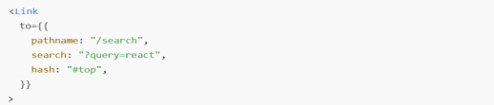
Link Tag
<Link> component is essential for enabling client-side navigation in your React applications. It serves as an enhanced <a> tag, allowing users to navigate between different routes without causing a full page reload.
The to prop can also accept an object, allowing for more complex navigation scenarios, such as including search parameters

Slide 29
Nested Route
A nested route is a route at which the component defined on that route is rendered as well as the component defined on its parent route is rendered.
Ex.
<Route path=’/parent’ element={<Parent />} >
<Route path=’child’ element={<Child /> /}
</Route>
Here,
The path of the parent route is automatically included in the child, so this config creates both "/parent" and "/parent/child" URLs.
Outlet
Here, when browser is on path /parent/child then both parent and child components will be rendered. The position of child component in UI is decided by Outlet component which is placed inside parent component.
Suppose we want the child component to be rendered as well on parent route and not on separate route. Then we can achieve that by using index prop on that child route

Slide 30
Layout Routes
Routes without a path create new nesting for their children, but they don't add any segments to the URL.
Consider a scenario where, we want to render some components on every route. For example, Header component. Each page in the app should have Header component. Now we can achieve that using nested routes.
Ex
<Route path=’/header element={<Header />} >
<Route path=’child1’ element={<Child1 /> }/>
<Route path=’child2’ element={<Child2 /> }/>
<Route path=’child3’ element={<Child3 /> }/>
</Route>
The issue here that for navigating to different page, url must have /header ex, /header/child1, header/child2 etc.
This occurrence of header in url is unnecessary, so to avoid that we can remove path from header route, which ensures that for every child route, header component will be there but there will be no /header in url.

Slide 31
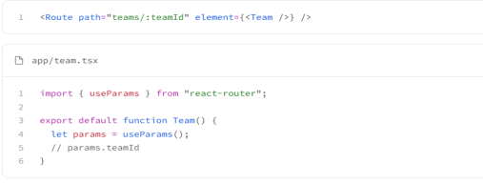
Dynamic Segments
If a path segment starts with : then it becomes a "dynamic segment". When the route matches the URL, the dynamic segment will be parsed from the URL and provided as params to other router APIs like useParams
There can be multiple dynamic segments in one path. Ex
/home/:productId/:skuId
Same will be accessible in the component using useParams() hook

Slide 32

No Route is Found
React router works top to bottom and matches the route, if none of the route is matched, then we can render any general not found component. This can be done by mention a route with path “*”. This is called a catch all routes, which will match any route.
Here, in browser if user navigate to any other route apart from / and /about then <NotFound /> component will be rendered.

Slide 33
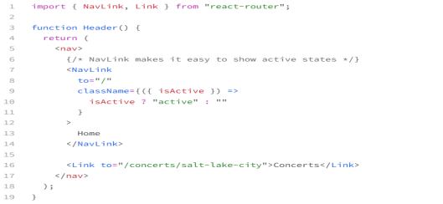
Navlink
Same as Link component, but this Navlink component comes in handy when we to style our anchor tag based on if it is active.
In className we can write a callback function which will have access to keyword isActive, which can be used to conditionally style our anchor tags.

Slide 34
Navigation
This hook allows the programmer to navigate the user to a new page without the user interacting.
For normal navigation, it's best to use Link or NavLink. They provide a better default user experience like keyboard events, accessibility labeling, "open in new window", right click context menus, etc.
Reserve usage of useNavigate to situations where the user is not interacting but you need to navigate, for example:
After a form submission completes
Logging them out after inactivity
Timed UIs like quizzes, etc.

Slide 35
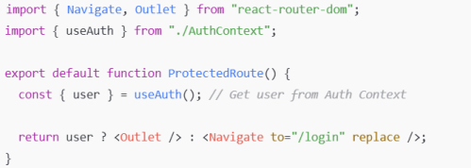
Protected Routes
These are the routes which are available only to authenticated users, for example a dashboard component. This component wont be available to guest users. To ensure that guest user dont end up on this route and see dashboard component. What we can do is make the dashboard component nested inside a protected route.
What will happen when user lands on /dashbord route, first parent component will be rendered, there we will check if the user is logged in or not. If user is logged in then we will renderer the <Outlet /> component meaning the dashboard component, otherwise we will redirect him to other route which can be login page for example.
Ex.

Slide 36
ESLint

Slide 37
Introduction to ESLint?
What is ESLint?
A static code analysis tool for identifying and fixing problems in JavaScript code.
Helps enforce coding standards and best practices.
Why Use ESLint?
Improve code quality and consistency.
Prevents potential bugs
Highly Customizable

Slide 38
Key Features of ESLint
Static Code Analysis - Detects potential errors and bugs in your code without executing it.
Customizable Rules - Allows you to configure rules to match your coding standards.
Plugin Support - Extends functionality with plugins for frameworks like React, Vue, Angular, etc.
Auto-fix - Automatically fixes some errors and formatting issues.
Integration - Works seamlessly with IDEs, build tools

Slide 39
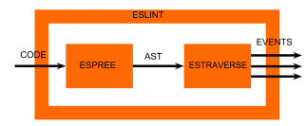
How ESLint Works?
Parsing: ESLint parses your JavaScript code into an Abstract Syntax Tree (AST).
Traversing: It traverses the AST to analyze the code structure.
Linting: It applies rules to detect issues or enforce coding standards.
Reporting: It outputs errors, warnings, or suggestions.

Slide 40
Configuring ESLint
eslint.config.js ->
ESLint Config JS file
Contains global settings and rules to enforce.
Configuring Rules -> can be configured in three ways:
"off" | 0 : Disable the rule.
"warn" | 1: Warn about the rule violation.
"error" | 2: Report as an error.

Slide 41
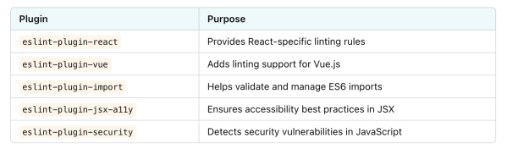
Plugins
A plugin in ESLint is an extra set of rules and configurations that ESLint doesn’t provide by default.
If you need framework-specific rules (like React or Vue) or additional best practices, you need plugins.

Slide 42
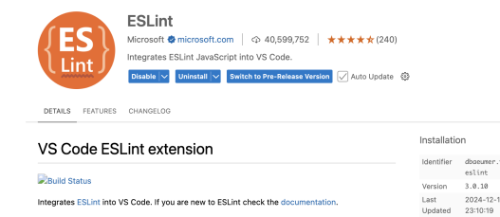
Using ESLint with Code Editors

Slide 43
Exercise
https://docs.google.com/document/d/11lssqncmATsdPIY1JJBQzVzEwO-1vedTZ5ViCrGZYc0/edit?tab=t.0

Slide 44
Feedback

Slide 45
Thank You

